Slide 1

AI Infrastructure
Ioannis Papapanagiotou
AI Components

Slide 2





5 Key components AI Infrastructure
Data Storage and Management
Compute Resources
Data Processing Frameworks
Machine Learning Frameworks
MLOps Platforms

Slide 3
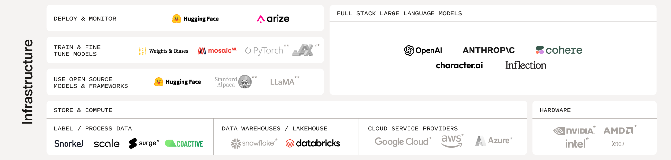
AI Infrastructure

Slide 4
The critical role of AI Infrastructure
AI Infrastructure is not just a technical foundation; it is a strategic asset that drives the success and innovation of AI projects. Its importance cannot be overstated, as it directly influences the efficiency, scalability, and effectiveness of AI solutions.
Enabling Advanced AI Capabilities: AI Infrastructure provides the necessary computational power and resources to support advanced AI technologies, such as deep learning and machine learning, allowing for more complex and accurate models.
Scalability and Flexibility: With the right infrastructure, organizations can scale their AI systems up or down based on demand, ensuring optimal performance and resource utilization. This flexibility is crucial for adapting to evolving business needs and data volumes.
Speed and Efficiency: High-quality AI infrastructure can significantly reduce the time required for data processing and model training, leading to faster insights and quicker decision-making processes.
Innovation and Competitive Advantage: Companies with robust AI infrastructure can more rapidly develop and deploy AI solutions, leading to innovation and a competitive edge in the market. It allows for experimenting with new AI models and techniques, driving forward technological advancements.
Risk Management and Reliability: Reliable AI infrastructure ensures that AI systems are secure, compliant, and resilient, minimizing downtime and reducing the risks associated with data breaches, system failures, and other operational disruptions.
Notes:
Enabling Advanced AI Capabilities: AI Infrastructure provides the necessary computational power and resources to support advanced AI technologies, such as deep learning and machine learning, allowing for more complex and accurate models.
Scalability and Flexibility: With the right infrastructure, organizations can scale their AI systems up or down based on demand, ensuring optimal performance and resource utilization. This flexibility is crucial for adapting to evolving business needs and data volumes.
Speed and Efficiency: High-quality AI infrastructure can significantly reduce the time required for data processing and model training, leading to faster insights and quicker decision-making processes.
Innovation and Competitive Advantage: Companies with robust AI infrastructure can more rapidly develop and deploy AI solutions, leading to innovation and a competitive edge in the market. It allows for experimenting with new AI models and techniques, driving forward technological advancements.
Risk Management and Reliability: Reliable AI infrastructure ensures that AI systems are secure, compliant, and resilient, minimizing downtime and reducing the risks associated with data breaches, system failures, and other operational disruptions.

Slide 5
Requirements
Understand your requirements: Before starting, clearly define your AI objectives and the problems you want to solve. This will guide the design of your AI infrastructure, including what hardware and software you'll need.

Slide 6
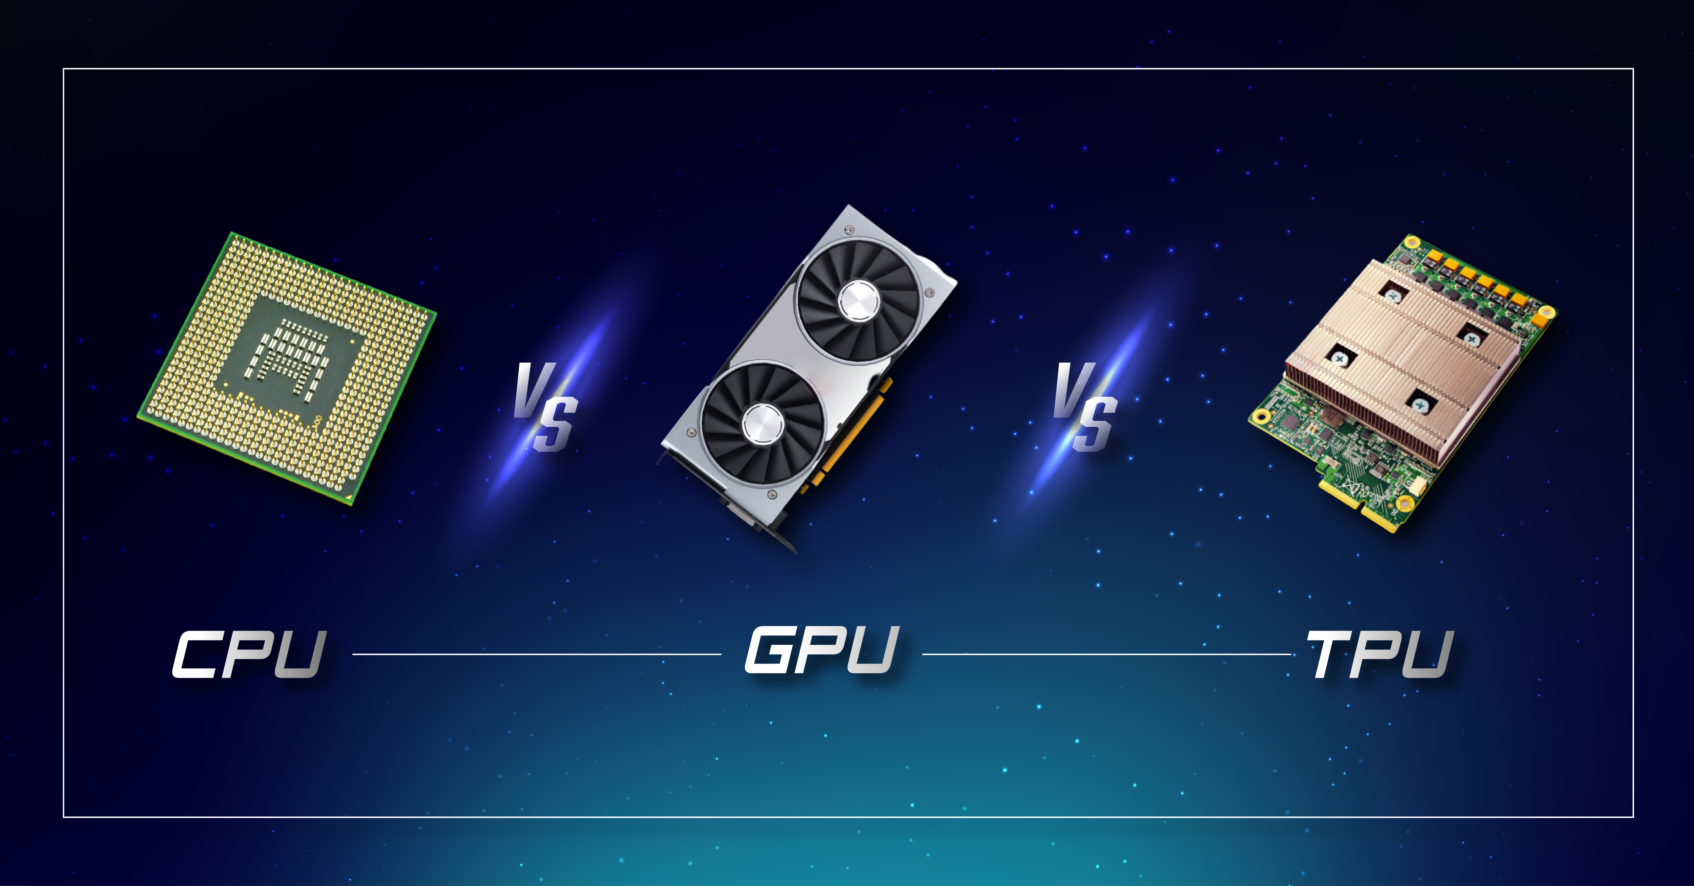
Elements of AI Infrastructure: Compute
Description: Compute resources, such as CPUs (Central Processing Units), GPUs (Graphics Processing Units), and TPUs (Tensor Processing Units), provide the processing power necessary for running AI algorithms and models.
Role in AI: They perform complex calculations at high speeds, which is crucial for tasks like training machine learning models, processing large datasets, and executing AI applications in real-time.
Hardware selection: AI workloads, especially deep learning, are computationally intensive and often benefit from specialized hardware. Graphics processing units (GPUs) are typically used for these tasks due to their parallel processing capabilities. Depending on your needs, you may also consider using tensor processing units (TPUs), or other specialized AI accelerators.

Slide 7
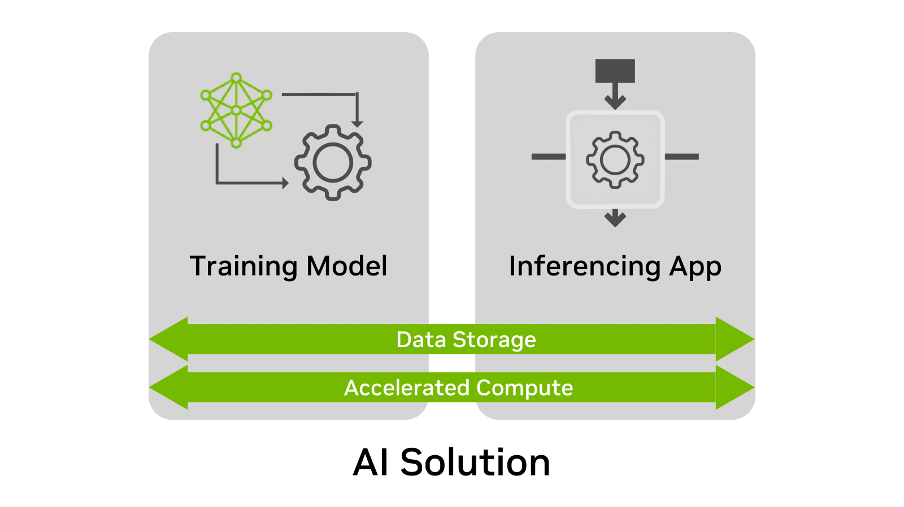
Elements of AI Infrastructure: Storage
Storage solutions manage the vast amounts of data used and generated by AI systems. This includes everything from raw data storage to processed data and model storage.
Role in AI: Efficient storage systems ensure quick access to data, facilitate data management, and support the iterative nature of AI model training and deployment.
Data storage and management: AI systems need access to large amounts of data. This requires robust data storage and management solutions that can handle high volumes of data, ensure data quality, and provide fast, reliable access.

Slide 8
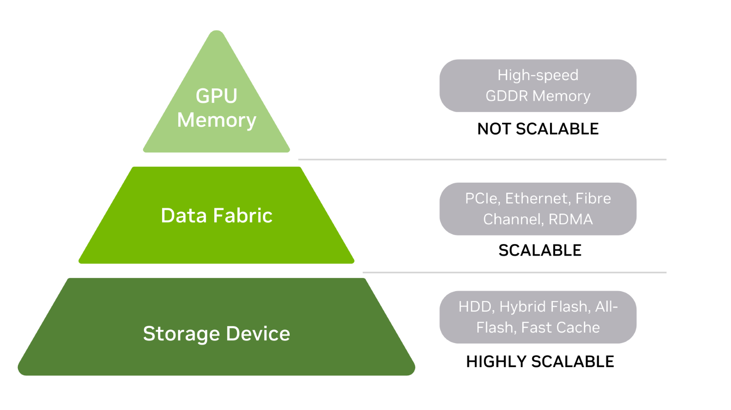
Data Hierarchy
Notes:
Storage devices
Hard drives and flash drives are at the base of the storage hierarchy. There are also hybrid arrays that are a combination of each. HDDs may be front-ended with a fast cache layer, while all-flash arrays may use storage-class memory (SCM) to improve read performance.
Fast storage is useful when the loading time for large datasets into GPU memory is important. When there is a need to train a model that no longer fits in the storage device, it is easy to scale storage capacity. It may also be that multiple datasets must be stored – an additional reason to have scalable storage.
Data fabric
In the middle of the hierarchy, data fabric is used to connect storage devices with GPU memory.
This layer includes:
PCIe bus
Network cards
DPUs
Any other card in the datapath between storage and GPU memory.
To keep things simple, the fabric can simply be viewed as a pass-through data layer between storage devices and GPU memory.
GPU memory
At the top of the storage hierarchy is GPU memory (often called vRAM.) Because GPU memory is fast and directly connected to the GPU, training datasets are processed quickly when the entire model resides within memory. CPU memory is also at the top of the hierarchy, just below GPU memory.
Alternatively, model data can be sent to GPU memory in multiple batches. Large GPU memory results in fewer batches and faster training time. If a GPU traverses across data fabric to internal or external storage for any part of the model or dataset, swapping activity to disk substantially reduces training performance.
Keep in mind that while storage devices and data fabric can scale, GPU memory is fixed. This means GPU memory is configured to the GPU and memory size cannot be upgraded to support larger training models and datasets.
The original GPU can use the memory of an added GPU if supported by the manufacturer, such as through NVIDIA NVLink. However, not all systems can accommodate a second GPU and the possibility of additional memory.
Ultimately, deployment plans should include a GPU with memory well in excess of current needs. Addressing a memory shortage in the future can be expensive.

Slide 9
Elements of AI Infrastructure: Networking
Networking infrastructure connects the various parts of AI systems, enabling data transfer and communication between compute nodes, data storage, and end-users.
Role in AI: High-speed and reliable networking are vital for data-intensive AI tasks, ensuring that data flows seamlessly across the infrastructure without bottlenecks, which is essential for real-time analytics and cloud-based AI services.
Networking: Efficient data flow is crucial in AI systems. High-bandwidth, low-latency networks can help move data quickly between where it's stored and where it's processed.

Slide 10
Elements of AI Infrastructure: Software & Frameworks
This includes the operating systems, AI frameworks (like TensorFlow or PyTorch), and development tools that provide the environment for building and running AI models.
Role in AI: These software tools and frameworks facilitate the development, training, and deployment of AI models, offering libraries and functions that accelerate the AI development process.
Software stack: Your AI infrastructure will need a software stack that includes machine learning libraries and frameworks (like TensorFlow, PyTorch, or Scikit-learn), a programming language (like Python), and possibly a distributed computing platform (like Apache Spark or Hadoop). You'll also need tools for data preparation and cleaning, as well as for monitoring and managing your AI workloads.

Slide 11

Building AI Infrastructure – Cloud or On-Prem
Cloud or on-premises: Decide whether to build your AI infrastructure in the cloud or on-premises. The cloud offers flexibility and scalability, but on-premises solutions may provide more control and better performance for certain workloads.
Scalability: Design your AI infrastructure to be scalable to handle increasing data volumes and more complex AI models. This might involve using distributed computing or taking advantage of the elastic resources available in the cloud.

Slide 12
Building AI Infrastructure – Cloud or On-Prem
Security and compliance: Implement security measures to protect your data and AI systems, and ensure that your AI infrastructure complies with any relevant laws and regulations, especially if you're dealing with sensitive or personal data.
Implementation: Once you've designed your AI infrastructure, you'll need to implement it. This involves setting up your hardware, installing and configuring your software, and testing everything to ensure it works as expected.
Maintenance and monitoring: Once your AI infrastructure is in place, you'll need to maintain and monitor it to ensure it continues to perform well. This includes regularly updating software, checking system health, and tuning performance.

